Slide 1


Renton Fish and Game Club
USPSA
March 2021
Match Booklet
Match Director: Jordan Rogers
Range Master: Marcel Englmaier
Stats: Eric Beerbaum
Round Count: 146

Slide 2
Stage 1 A Tale of Three Windows Course Designer: Marcel Englmaier
A Tale of Three Windows is a 21 round, 105 point Comstock Long course. There are 10 USPSA targets and 1 steel target. The best two hits per target will score. Steel must fall to score. The start signal is audible.
The Handgun start position is standing with heels touching either set of marks and wrists below belt. Handgun loaded and holstered. The PCC start position is standing with heels touching either set of marks. PCC loaded, stock on belt, muzzle pointing down range.
On the audible start signal, engage all targets from within the shooting area. Knockdown steel closes center window and opens outer windows.

Slide 3
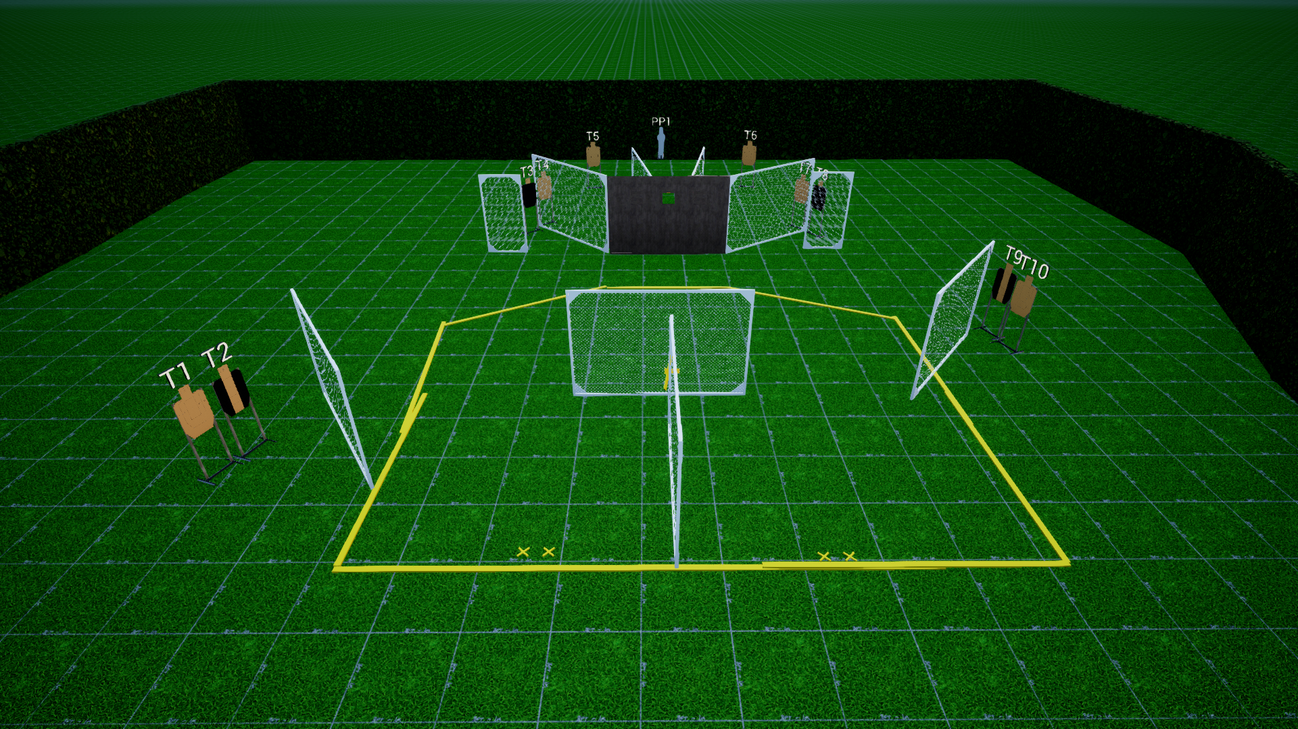
 | Stage 1 A Tale of Three Three Windows Course Designer: Marcel Englmaier

Slide 4
Stage 2 Untitled Standards Course Designer: Jordan Rogers
Untitled Standards is a 20 round, 100 point Virginia Count standards exercise. There are 10 USPSA target. The best two hits per target will score. The start signal is audible.
START POSITION Strings 1 & 2: Standing anywhere within either shooting area. Handgun Loaded and holstered. PCC loaded, stock on belt, muzzle pointing down range.
STAGE PROCEDURE String 1: On the audible start signal, engage targets T1-3 OR T8-10 with two rounds each, perform a mandatory reload and engage the remaining array with two rounds each STRONG HAND/SIDE ONLY String 2: On the audible start signal, engage T4 and T7, OR T5 & T6 with two rounds each, perform a mandatory reload and engage the remaining array with two rounds each WEAK HAND/SIDE ONLY. The walls DO NOT extend to infinity, targets may be engaged from below.

Slide 5
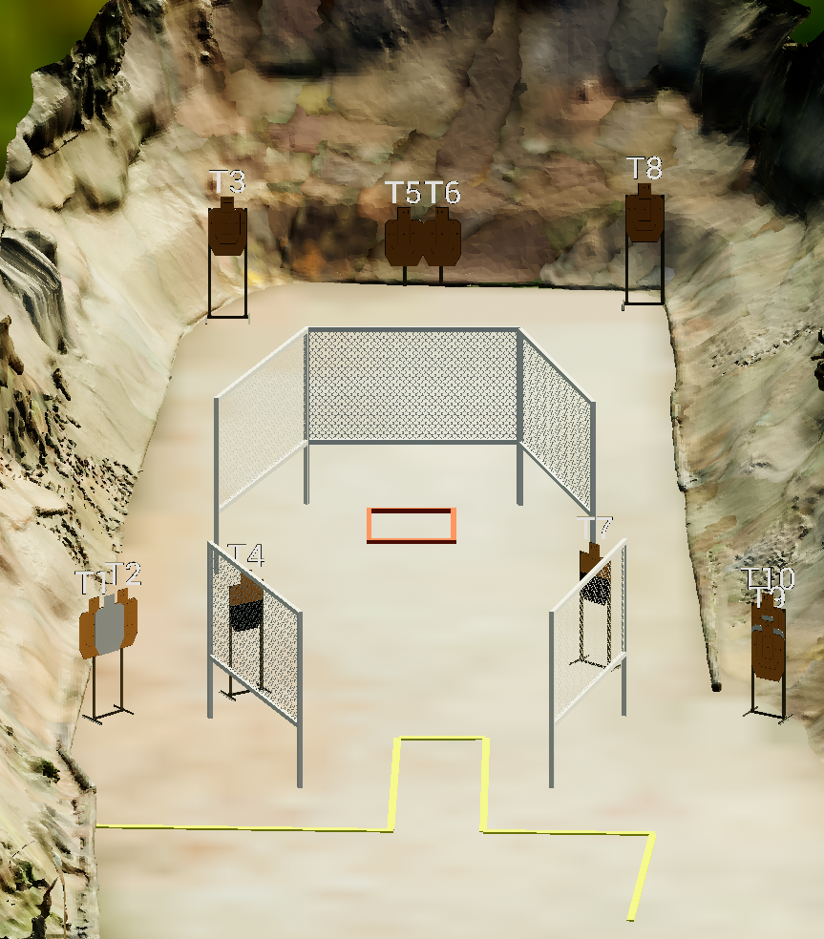
 | Stage 2 Untitled Standards Course Designer: Jordan Rogers

Slide 6
Stage 3 Four Square Course Designer: Jordan Rogers
Four Square is a 25 round, 125 point Comstock long course. There are 10 USPSA targets and 5 steel targets. The best two hits per target will score. Steel must fall to score. The start signal is audible.
The handgun start position is standing with toes touching any barrel, handgun unloaded and holstered with wrist above shoulders. All ammunition loading devices to be used during the course of fire must be staged on a barrel prior to the start signal. The PCC start position is standing with toes touching any barrel, PCC unloaded with stock on belt, muzzle pointed down range. All ammunition loading devices to be used during the course of fire must be staged on a barrel prior to the start signal.
On the audible start signal, engage all targets as visible from within the shooting boxes.

Slide 7
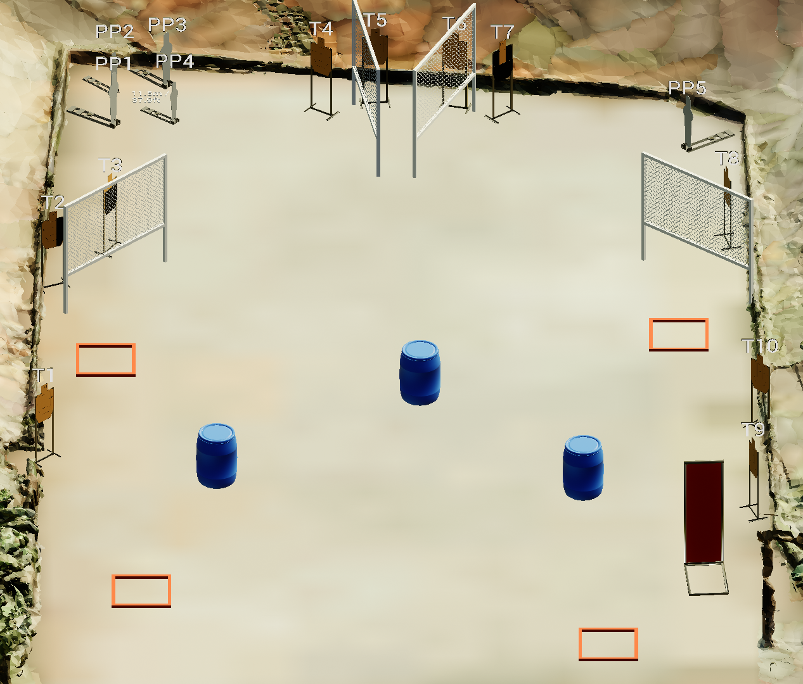
 | Stage 3 Four Square Course Designer: Jordan Rogers

Slide 8
Stage 4 Smooth-brain Criminal Course Designer: Eric Beerbaum
Smooth-brain Criminal is a 20 round, 100 point Comstock medium course. There are 8 USPSA targets and 4 steel targets. The best two hits per target will score. Steel must fall to score. The start signal is audible.
The start position is standing with both feet touching Xs, facing downrange. Handgun loaded and holstered, wrists below belt. PCC loaded, stock on belt, muzzle pointing down range.
On the audible start signal, engage targets as visible from within the shooting areas.

Slide 9
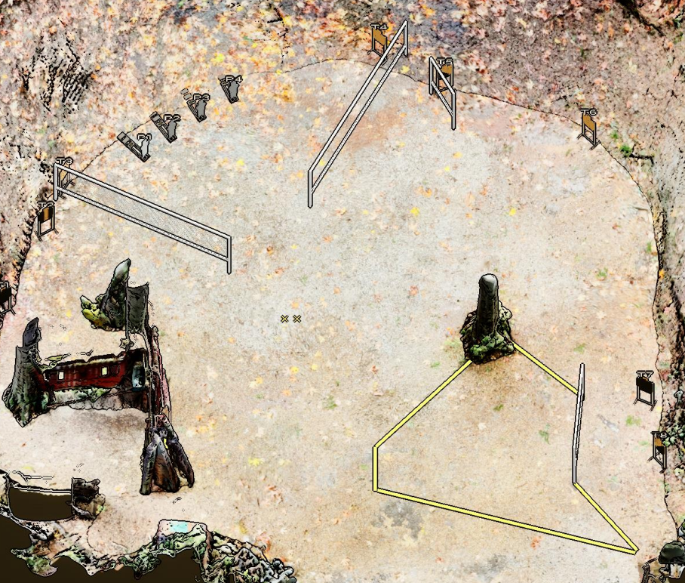
 | Stage 4 Smooth-brain Criminal Course Designer: Eric Beerbaum

Slide 10
Stage 5: CM 99-07 Both Sides Now #1

Slide 11
Stage 6 Changing Up The Norm Course Designer: Marcel Englmaier
Changing Up The Norm is a 20 round, 100 point Comstock Long Course. There are 10 USPSA targets. The best two hits per target will score. The start and stop signal are audible.
The Handgun start position is standing with toes touching Xs and wrists below belt. Handgun is loaded and holstered. The PCC start position is standing with toes touching Xs both hands grasping PCC. PCC is loaded with safety on and stock on belt, muzzle pointed down range.
On the audible start signal, engage all targets from behind the fault line. All barrels are soft cover.

Slide 12
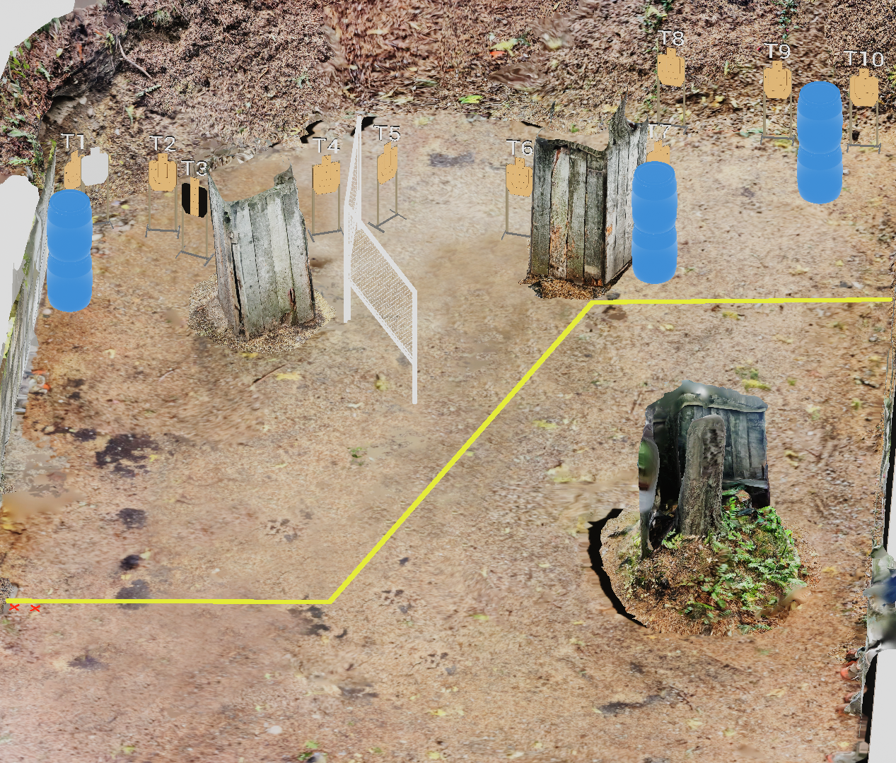
 | Stage 6 Changing Up The Norm Course Designer: Marcel Englmaier

Slide 13
Stage 7 Aim Faster Course Designer: Eric Beerbaum
Aim Faster is a 22 round, 110 point Comstock long course. There are 11 metric targets. The best two hits per target will score. The start signal is audible.
The Handgun start position is standing anywhere outside shooting area, handgun loaded and holstered, wrists below belt. The PCC start position is standing anywhere outside shooting area, PCC loaded, stock on belt, muzzle pointing down range.
On the audible start signal, engage targets as they become visible.

Slide 14
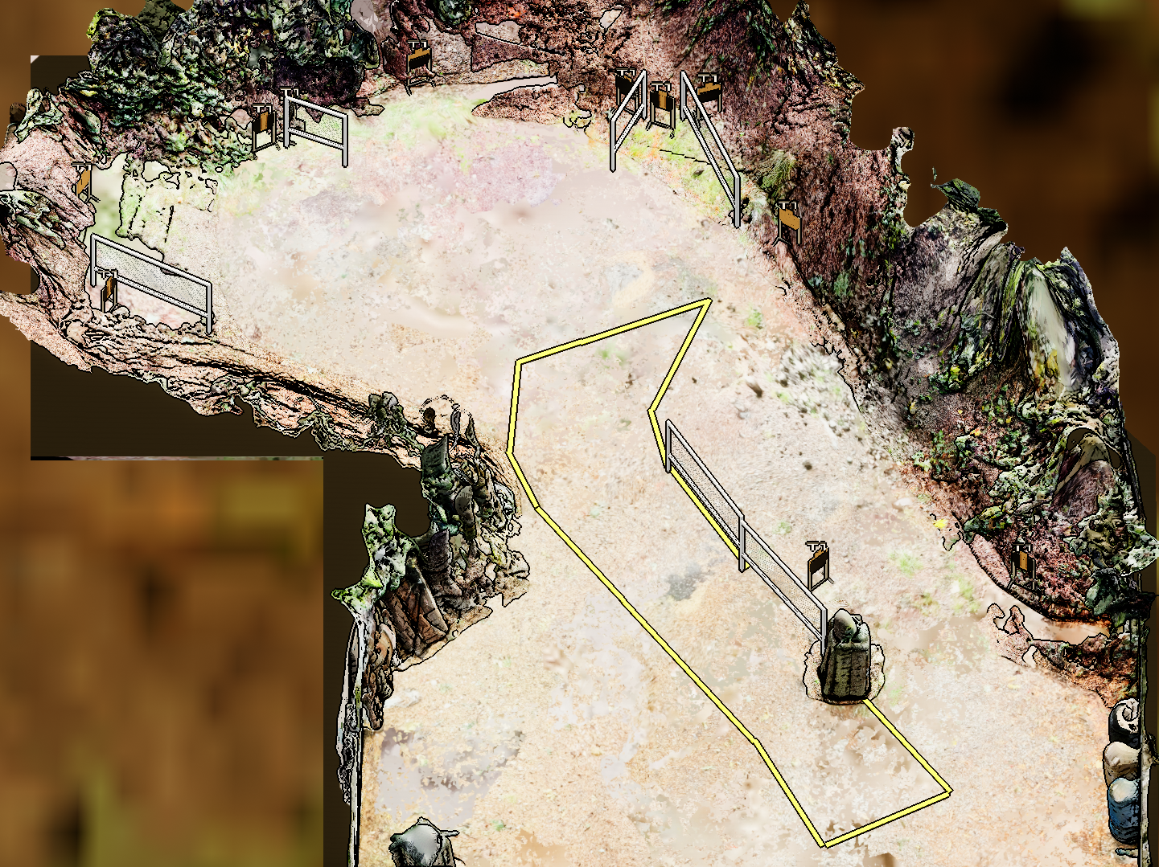
 | Stage 7 Aim Faster Course Designer: Eric Beerbaum
Notes:
‹#›

